Slide 1


Westminster Legal Policy Forum Keynote Seminar
15 July 2015
Judicial review in England and Wales - context and challenges ahead
Maurice Sunkin
University of Essex
sunkm@essex.ac.uk

Slide 2
Context
Now recognised that the effect of JR on the practical exercise of power is constant and central. (De Smith’s JR)
The past few decades have seen a substantial increase in the overall scale of JR litigation.
The threat of JR is now an everyday risk for public bodies
JR is daily in the news.
Recent reforms have aimed at:
  decentralising JR;
  relieving the Admin Court by transferring immig to the UT;
  speeding the process and improving the Admin Court’s ability to deal with planning; and
  curtailing the more general use of JR .

Slide 3
Some elementary propositions
The inherent jurisdiction to supervise the legality of government action is fundamental to our constitutional system and rooted in the rule of law.
It is not a luxury or a matter of government largesse.
The need to ensure that public bodies are legally accountable is fundamental to good government and democratic accountability.
There is a partnership between judges and public authorities ‘… based on a common aim, namely the maintenance of the highest standards of public administration’,
Per Lord Donaldson MR, parte Huddleston (1986)

Slide 4
Government and curtailing the use of JR
The ability of a government to curtail legal scrutiny of how it exercises public powers is a constitutionally significant matter.
It would be fundamentally inconsistent with the rule of law to enable a government to determine whether, and to what extent, it is legally accountable.
In our system government can only limit its legal accountability if it can persuade Parliament that the proposed limitation is necessary and proportionate.
Limiting accountability is one thing: removing it is another. It’s by no means clear that Parliament could remove JR altogether.

Slide 5
Three questionable assumptions influence much discussion of JR
That the growth in the use of JR has been largely driven by claimants bringing weak claims or abusing the process.
That JR tends to impede good administration especially by causing delay and adding collateral cost.
That much JR litigation is not worth the fuss and bother, because it is about process and does not alter outcomes.

Slide 7
Growth: what growth?
Aside from immigration and asylum, there’s no evidence of a significant increase in JR claims since the early to mid 1990s.
Scale of JR has remained ‘infinitesimal’ relative to that of government decision-making and may have declined in relative terms.
Number of final hearings has remained fairly constant at around 400-500 per annum.

Slide 8
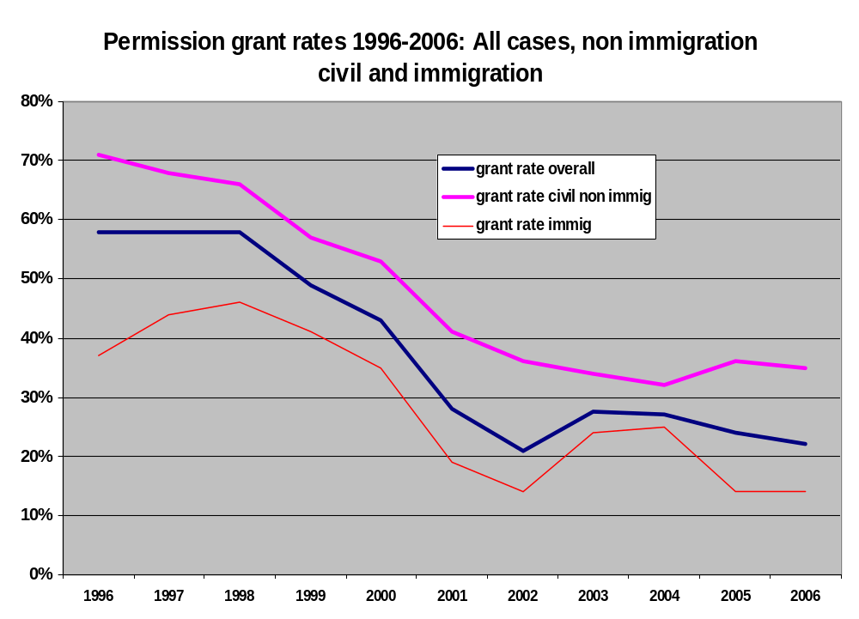

Slide 9
Claimant success is often underestimated
MoJ say that official statistics show that claimants are only successful in around 2% of claims. This is misleading: T. Hickman and M. Sunkin, ‘Success in Judicial Review: The Current Position’ (http://ukconstitutionallaw.org/)
While only a small minority of claims are granted permission a substantial proportion are settled prior to permission in the claimant’s favour.
Bondy and Sunkin found that 34 % of JR claims were w/d prior to permission, almost all following settlements in favour of claimants. Bondy & Sunkin (2009) Public Law 237
Around 40% of final hearings are decided in the claimants’ favour.

Slide 10
Assumption 2: JR impedes good government
JR may cause delay and cost. It may also upset budgets and force reassessment of priorities and policies. It may also require public bodies to approach decision-making differently.
But research suggests that JR also improves the quality of public services: see Sunkin et al: ‘Judicial Review and the Quality of local authority services’, Journal of Public Administration Research and Theory (2010), 20:i243-i260 .
Where LAs experienced an increase in the incidence of JR challenge, the quality of their services improved as measured by Comprehensive Performance Assessment (CPA) scores.
Since improvements were associated with an increase in JR the findings question the assumption that JR impedes good administration, eg by diverting resources from service delivery.

Slide 11
Assumption 3: JR is not worth the fuss and bother
Assumed that much JR litigation is about procedural matters and does not affect outcomes.
A motivation for Section 84 of the Criminal Courts and Justice Act 2015: relief/leave is to be refused where “it is highly likely that that the outcome for the applicant would not have been substantially different if the conduct complained of had not occurred”.
But assumption also widely held amongst academics that: “a successful [JR]...would most likely be followed by an agency remaking the same decision, though taking care to avoid the earlier legal error” (Creyke and McMillan)

Slide 12
Research on the effects of JR on claimants
Bondy, Platt and Sunkin, Judicial Review: the nature of claims, their outcomes and effects: report of a Nuffield funded study (to be published).
Following based on what we were told by claimant lawyers involved with 198 cases.
Judicial outcome favoured the claimant in 100 of the cases.
In 43 a decision was quashed or declared unlawful and was reconsidered.
In 34 of these cases there were known outcomes
In only 4 was the outcome unfavourable to the claimant.
In 30 cases the public body made a fresh decision that favoured the claimant.

Slide 13
Challenges Ahead
I’ve not mentioned costs, nor reductions in legal aid which are adversely affecting access to justice, including JR.
As well as increasing unmet needs for redress, these reductions are also creating other problems for courts, including how to ensure justice to increasing numbers of self represented litigants
JR is part of a large and complex ‘system’ of administrative justice. A major challenge ahead is to ensure that this ‘system’ is capable of meeting needs.
JR rightly attracts attention but it is often used because other potentially more proportionate and accessible routes to redress either do not exist or have failed.
My comments underline the value of robust empirical data to inform evidence based decision making. In this context, see the work of The United Kingdom Administrative Justice Institute (UKAJI) at www.ukaji.org

